Slide 1
Business Statistics:
A First Course
(3rd Edition)
Chapter 6
Sampling Distributions
and
Confidence Interval Estimation

Slide 2

Chapter Topics
Sampling Distribution of the Mean
Estimation Process
Point Estimates
Interval Estimates
Confidence Interval Estimation for the Mean
( Known)
Determining Sample Size

Slide 3
Chapter Topics
(continued)
Confidence Interval Estimation for the Mean
( Unknown)
Confidence Interval Estimation for the Proportion
Confidence Interval Estimation and Ethical Issues

Slide 4
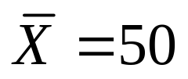

Why Study Sampling Distributions
Sample Statistics are Used to Estimate Population Parameters
  e.g. estimates the population mean
Problem: Different Samples Provide Different Estimates
  Large sample gives better estimate; large sample costs more
  How good is the estimate?
Approach to Solution: Theoretical Basis is Sampling Distribution

Slide 5
Sampling Distribution
Theoretical Probability Distribution of a Sample Statistic
Sample Statistic is a Random Variable
  Sample mean, sample proportion
Results from Taking All Possible Samples of the Same Size

Slide 6



Developing Sampling Distributions
Suppose There is a Population …
Population Size N=4
Random Variable, X,
is Age of Individuals
Values of X : 18, 20,
22, 24 Measured in
Years
B
C
D
A

Slide 7
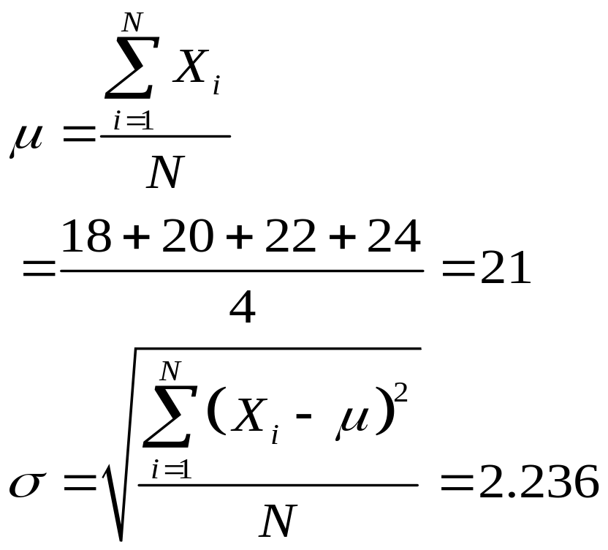
Developing Sampling Distributions
(continued)
Summary Measures for the Population Distribution
P(X)
.3
.2
.1
0
A B C D
(18) (20) (22) (24)
X
Uniform Distribution

Slide 8
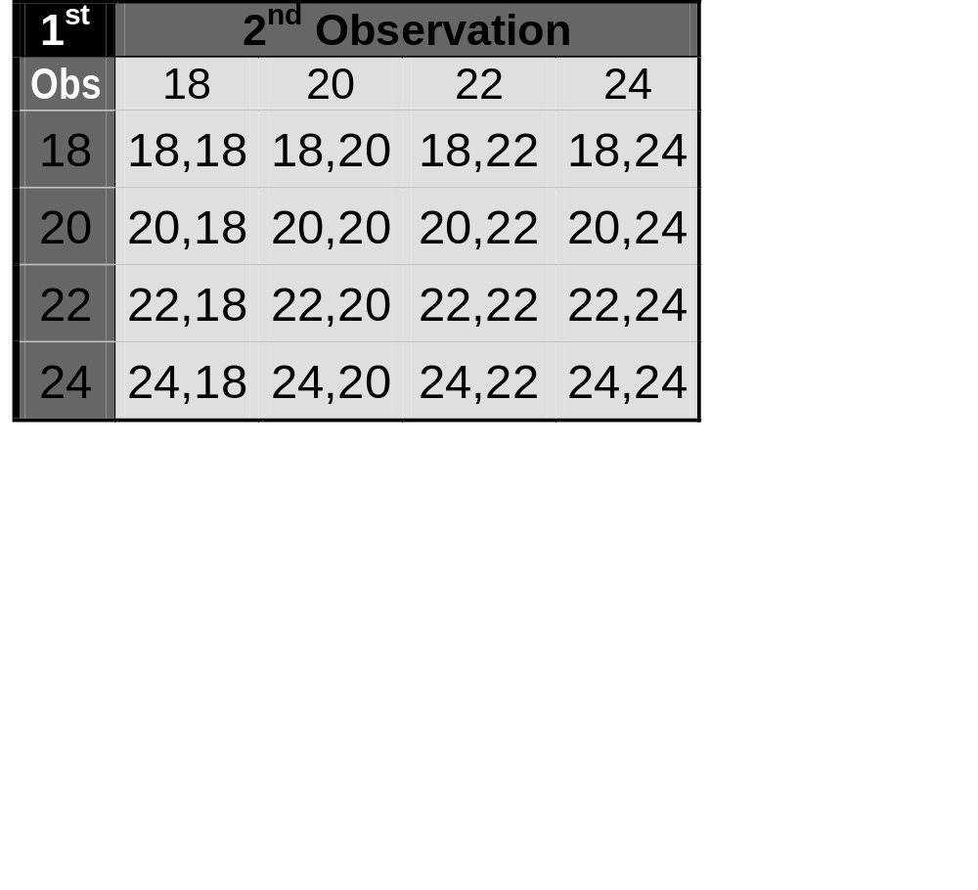
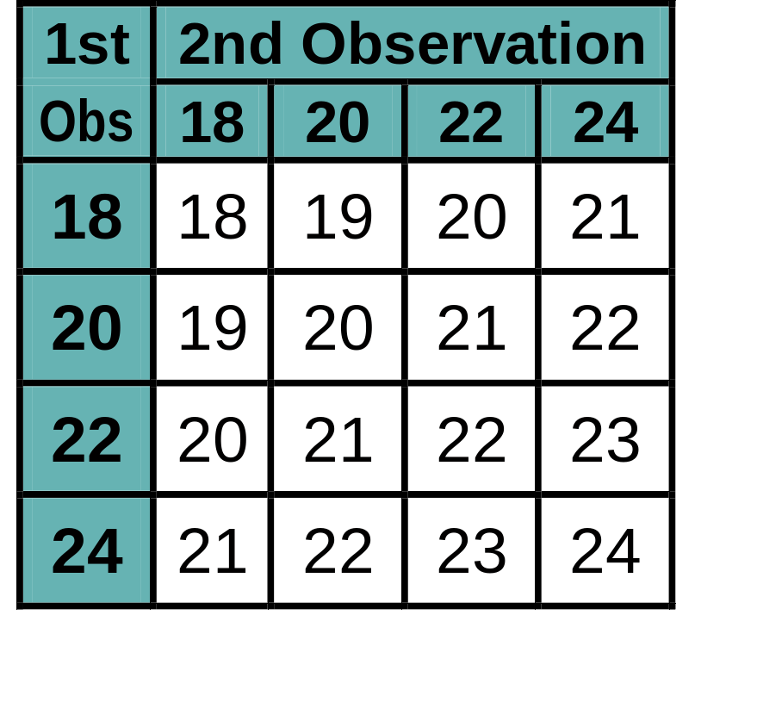
All Possible Samples of Size n=2
Developing Sampling Distributions
(continued)
16 Sample Means
16 Samples Taken with Replacement

Slide 9
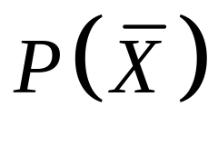
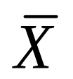
Sampling Distribution of All Sample Means
Developing Sampling Distributions
(continued)
16 Sample Means
Sample Means Distribution
.3
.2
.1
0
18 19 20 21 22 23 24

Slide 10
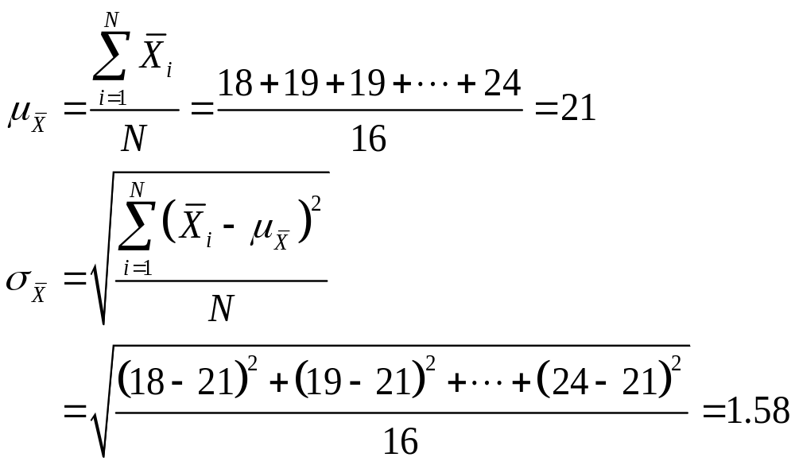
Summary Measures of Sampling Distribution
Developing Sampling Distributions
(continued)

Slide 11
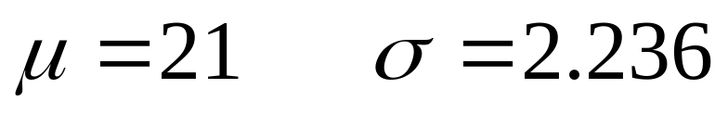
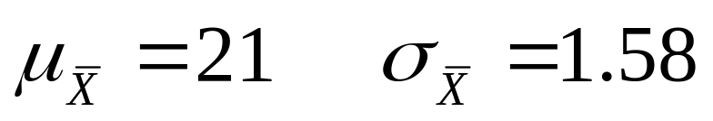
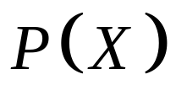

Comparing the Population with its Sampling Distribution
Population
N = 4
Sample Means Distribution
n = 2
.3
.3
.2
.2
.1
.1
0
0
A B C D
(18) (20) (22) (24)
18 19 20 21 22 23 24

Slide 12
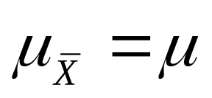
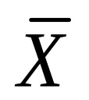
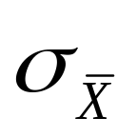
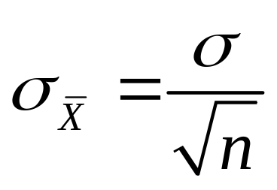
Properties of Summary Measures
  i.e. is unbiased
Standard Error (Standard Deviation) of the Sampling Distribution is Less than the Standard Error of Other Unbiased Estimators
For Sampling with Replacement or without Replacement from Large or Infinite Populations:
  As n increases, decreases

Slide 13
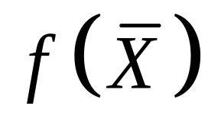
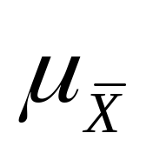
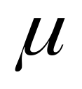
Unbiasedness
Unbiased
Biased

Slide 14
Less Variability
Sampling Distribution of Median
Sampling Distribution of Mean

Slide 15
Effect of Large Sample
Larger sample size
Smaller sample size

Slide 16
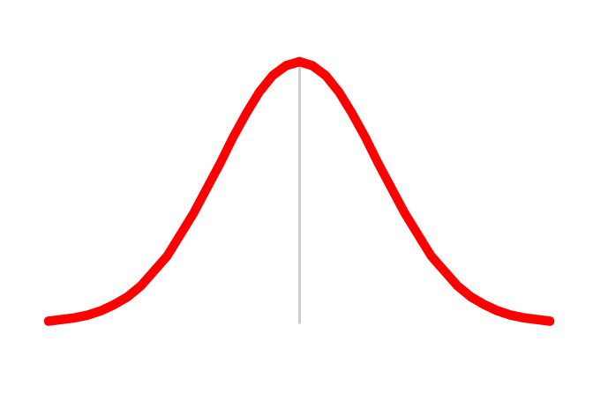

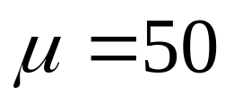
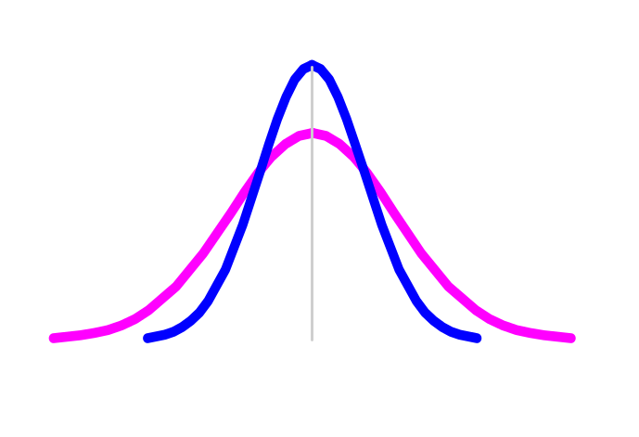
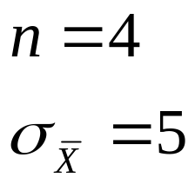
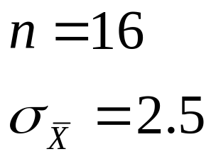
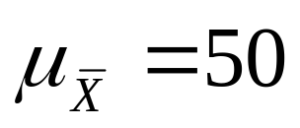
When the Population is Normal
Population Distribution
Central Tendency
Variation
Sampling Distributions

Slide 17
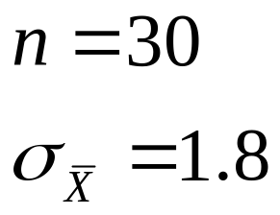
When the Population is Not Normal
Population Distribution
Central Tendency
Variation
Sampling Distributions

Slide 18
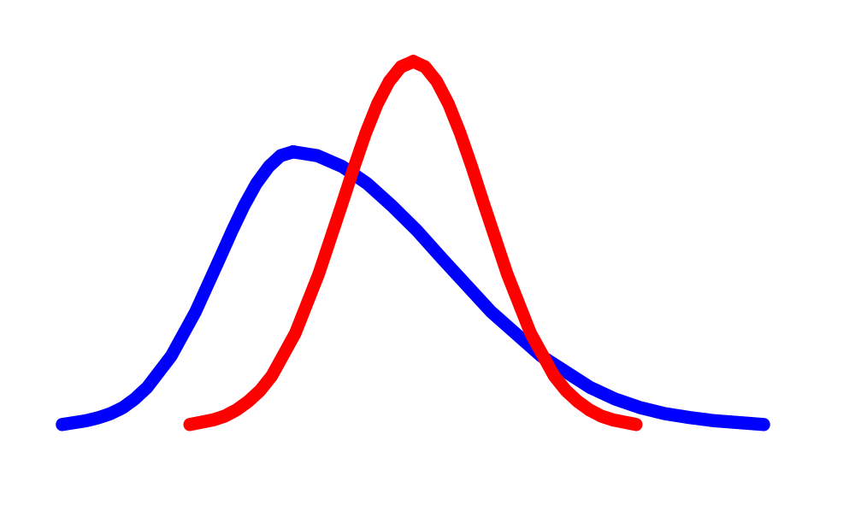
Central Limit Theorem
Sampling Distribution Becomes Almost Normal Regardless of Shape of Population
As Sample Size Gets Large Enough

Slide 19
How Large is Large Enough?
For Most Distributions, n>30
For Fairly Symmetric Distributions, n>15
For Normal Distribution, the Sampling Distribution of the Mean is Always Normally Distributed

Slide 20
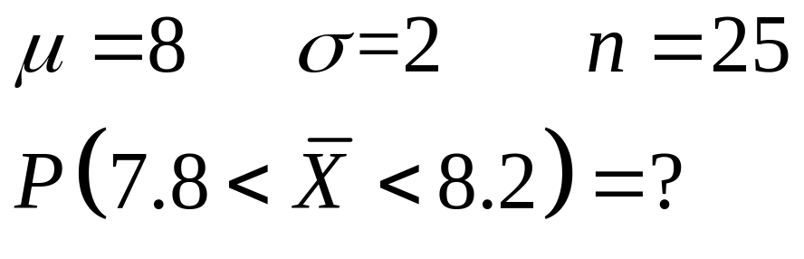
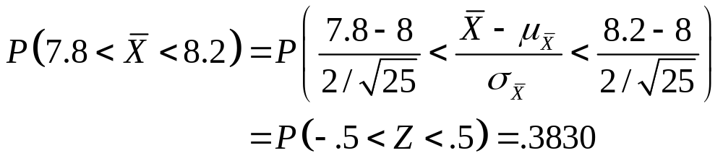
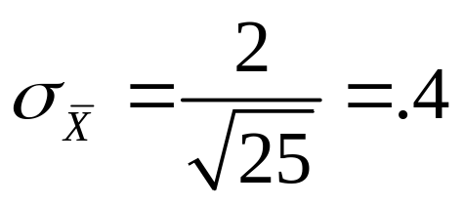
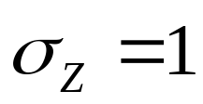






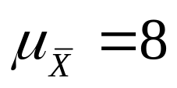
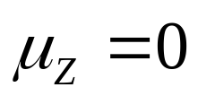
Example:
Sampling Distribution
Standardized
Normal Distribution

Slide 21


Estimation Process
Population
Random Sample
I am 95% confident that μ is between 40 & 60.
Mean
X = 50
Mean, μ, is unknown
Sample

Slide 22
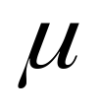

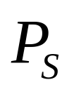
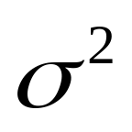
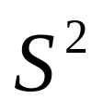
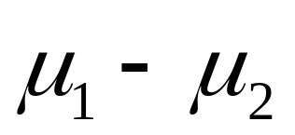
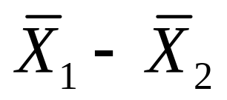
Point Estimates
Estimate Population
Parameters …
with Sample
Statistics
Mean
Proportion
Variance
Difference

Slide 23
Interval Estimates
Provides Range of Values
  Take into consideration variation in sample statistics from sample to sample
  Based on observation from 1 sample
  Give Information about Closeness to Unknown Population Parameters
  Stated in terms of level of confidence
    Never 100% sure

Slide 24
Confidence Interval Estimates
Confidence
Intervals
Mean
Proportion
σ
Known
σ
Unknown

Slide 25


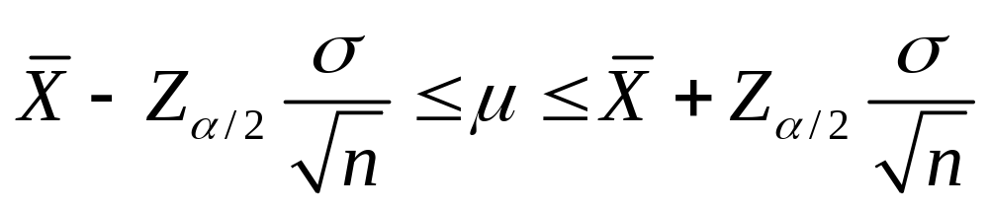
Confidence Interval for
( Known)
Assumptions
  Population standard deviation is known
  Population is normally distributed
  If population is not normal, use large sample
Confidence Interval Estimate

Slide 26
Elements of Confidence Interval Estimation
Level of Confidence
  Confidence that the interval will contain the unknown population parameter
Precision (Range)
  Closeness to the unknown parameter
Cost
  Cost required to obtain a sample of size n

Slide 27
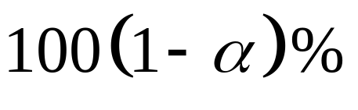
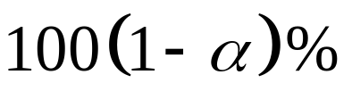
Level of Confidence
Denoted by
A Relative Frequency Interpretation
  In the long run, of all the confidence intervals that can be constructed will contain (bracket) the unknown parameter
A Specific Interval Will Either Contain or Not Contain the Parameter
  No probability involved in a specific interval

Slide 28

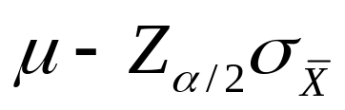

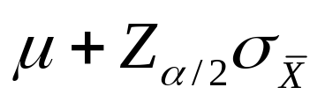
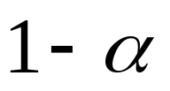
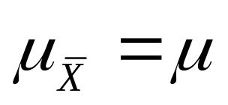
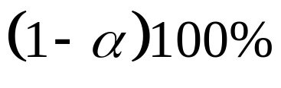
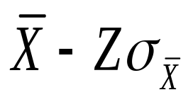
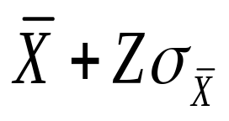


Interval and Level of Confidence
Sampling Distribution of the Mean
_
Intervals extend from
to
of intervals constructed contain ;
do not.
Confidence Intervals

Slide 29

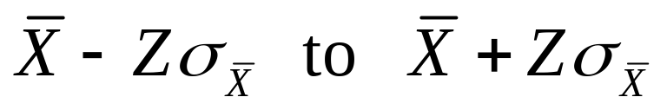
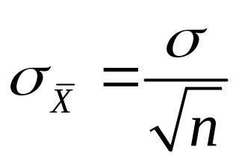
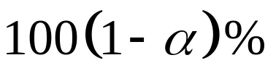
Factors Affecting Interval Width
(Precision)
Data Variation
  Measured by
Sample Size
Level of Confidence
Intervals Extend from
© 1984-1994 T/Maker Co.

Slide 30

Determining Sample Size (Cost)
Too Big:
Requires more resources
Too small:
Won’t do the job

Slide 31

Determining Sample Size for Mean
What sample size is needed to be 90% confident of being correct within ± 5? A pilot study suggested that the standard deviation is 45.
Round Up

Slide 32

Determining Sample Size for Mean in PHStat
PHStat | Sample Size | Determination for the Mean …
Example in Excel Spreadsheet

Slide 33

Confidence Interval for
( Unknown)
Assumptions
  Population standard deviation is unknown
  Population is normally distributed
  If population is not normal, use large sample
Use Student’s t Distribution
Confidence Interval Estimate

Slide 34
Student’s t Distribution
Standard Normal
Bell-Shaped
Symmetric
‘Fatter’
Tails
t (df = 13)
t (df = 5)
Z
t
0

Slide 35

Degrees of Freedom (df )
  Number of Observations that are Free to Vary after Sample Mean has been Calculated
  Example
    Mean of 3 numbers is 2
degrees of freedom
= n -1
= 3 -1
= 2

Slide 36
Student’s t Table
Let: n = 3
df = n - 1 = 2
α = .10
α/2 =.05
Upper Tail Area
df
.25
.10
.05
1
1.000
3.078
6.314
α / 2 = .05
2
0.817
1.886
2.920
3
0.765
1.638
2.353
0
t
2.920
t Values

Slide 37


Example

Slide 38
Confidence Interval for
( Unknown) in PHStat
PHStat | Confidence Interval | Estimate for the Mean, sigma unknown
Example in Excel Spreadsheet

Slide 39



Confidence Interval Estimate for Proportion
Assumptions
  Two categorical outcomes
  Population follows Binomial distribution
  Normal approximation can be used if
  and
  Confidence Interval Estimate

Slide 40

Example
A random sample of 400 Voters showed 32 preferred Candidate A. Set up a 95% confidence interval estimate for p.

Slide 41
Confidence Interval Estimate for Proportion in PHStat
PHStat | Confidence Interval | Estimate for the Proportion …
Example in Excel Spreadsheet

Slide 42

Determining Sample Size for Proportion
Out of a population of 1,000, we randomly selected 100 of which 30 were defective. What sample size is needed to be within ± 5% with 90% confidence?
Round Up

Slide 43

Determining Sample Size for Proportion in PHStat
PHStat | Sample Size | Determination for the Proportion …
Example in Excel Spreadsheet

Slide 44
Ethical Issues
Confidence Interval (Reflects Sampling Error) Should Always be Reported Along with the Point Estimate
The Level of Confidence Should Always be Reported
The Sample Size Should be Reported
An Interpretation of the Confidence Interval Estimate Should Also be Provided

Slide 45
Chapter Summary
Discussed Sampling Distribution of the Sample Mean
Illustrated Estimation Process
Discussed Point Estimates
Addressed Interval Estimates
Discussed Confidence Interval Estimation for the Mean ( Known)
Addressed Determining Sample Size

Slide 46
Chapter Summary
(continued)
Discussed Confidence Interval Estimation for the Mean ( Unknown)
Discussed Confidence Interval Estimation for the Proportion
Addressed Confidence Interval Estimation and Ethical Issues

